Slide 1
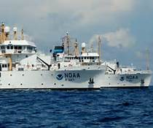
Quarterly Report: NWS Evolve Briefing for Deputy Secretary Andrews
Dr. Louis W. Uccellini and Laura K. Furgione
Director and Deputy Director, National Weather Service
NOAA Assistant Administrator for Weather Services
July 25, 2016
Notes:
Major theme of presentation: show HQ functions transparently. Clarify why actions are occurring.
Changes are the basis for moving forward. There is no magic bullet to ensure success. Greatest uncertainty is the budget situation.

Slide 2
Agenda
Bottom Line Up Front
Update on the Collective Bargaining Agreement Renegotiation and Other NWSEO Engagement
Filling Vacancies
APG Update
OWA Update

Slide 3
Bottom Line Up Front
Review key milestones and program highlights
Stall tactics on CBA Renegotiation continue from NWSEO
Filling vacancies still a major challenge
Operations and Workforce Analysis continues to make headway
Directed at providing Impact-based Decision Support Services (IDSS) to Build a WRN
Exploring and refining ways to unlock FTE to focus on IDSS
Agency Priority Goal - Continued progress has been made and the performance measure is on target to be met in Q4 FY17

Slide 4
Key Milestones to Evolve the NWS
FY 17 Includes:
Test & evaluate recommendations from Operations & Workforce Analysis
Continue National Water Center baseline staffing
Expand geographic domain and breadth of water information
Enhance integrated dissemination systems
Initiate ASOS SLEP/Continue NEXRAD SLEP
Complete facilities assessment
Operational: integrated dissemination system
FY 15 Includes:
New budget structure implemented
NWS HQ reorganization underway
Develop Transformational Change process and governance
Initiate Operations & Workforce Analysis
National Water Center Initial Operating Capability
AWIPS II Deployment complete
NEXRAD SLEP underway
Initiate Strategic Office Relocations
Initiate facilities assessment
FY 14 Included:
Submit NWS Budget Restructuring
National Water Center Staffing Initiated
NWS HQ Reorganization requested
Dissemination systems assessment and consolidation initiated
WRN Ambassador Initiative launched
Establish a Transformational Change Framework
FY18-23+
FY17
FY 18 and Beyond Includes:
Implement Operations & Workforce Analysis recommendations
Fully Integrated Field Structure delivering consistent products and services
FACETS and Warn-on-Forecast
National Water Center baseline staffing complete
Complete NEXRAD and ASOS SLEP
FY16
FY15
FY 16 Includes:
Operations & Workforce Analysis complete w/recommendations
Supercomputing capacity increased
Complete communications upgrade to field offices
Implement National Blend of Models v1.0
Conduct Operational Test & Evaluation of Impact-Based Decision Support Catalog
Implement Experimental NWC Centralized Water Forecast Modeling System v1.0
Assess weeks 3-4 experimental temperature and precipitation outlook products
Prototype coupled ocean-atmosphere-ice model
FY14
Notes:
Louis: OWA is part of Evolve -- NWS began the Operations and Workforce Analysis (OWA) in 2015 to reach the strategic vision of “Weather-Ready Nation”.
[If needed] Phases of work and objectives include:
Diagnostic: Current state baseline and current state gaps
Understand and baseline current state organizational structure, workforce model, and operating model through a comprehensive assessment and analysis
Focus in particular on better qualifying and quantifying Impact-Based Decision Support Services (IDSS), which is the support provided to partners to translate forecasts into decisions
Identify gaps in the current state operations, workforce, and organization required to achieve a Weather-Ready Nation (WRN) and thus support IDSS
Stakeholder Engagement and Change Management:
Develop the capacity to involve stakeholders throughout the project
Recommendation of Alternatives:
Develop recommendations for evolving NWS from current to future state to close gaps, leverage state-of-the-art science and technology, consider geographic differences, and enable services and workforce concepts in NWS strategic documents
Implementation Planning:
Advance recommendations to action through plans, quick wins, and phased implementation

Slide 5
Cross-Cutting Issues and Concerns: Labor – Management Relationship
Actions:
CBA Renegotiation, Engaging NWSEO on the OWA Project, Bargaining other Evolve NWS issues
Help Requested from DOC:
Be available to maintain/garner additional support on Hill, as needed.
Progress | Concerns
Currently: Impasse on 1 sentence of 1 Article of the Ground rules for CBA renegotiation. Related to who can reopen articles after reaching tentative agreement. Working on Options with FSIP to expedite a decision. | Ongoing: Speed of CBA renegotiation and our ability to negotiate several other big ticket items in parallel. FSIP meets quarterly and not until mid-Sep.
Update: NWS has just hired a strategic Comms expert to help win messaging battle with NWSEO
Ongoing: NWS-NWSEO Strategic Dialogue Team | Meetings have ceased since May.
Ongoing: National Labor Council — Successful negotiations to speed up hiring and stand up ROCs | Looking to formally bargain over ROCs in a timely fashion given CBA renegotiation. Grievance filed by NWSEO over Hiring MOU related to PCS past practice
Notes:
TPS: Agreement on Interns and/or ROC

Slide 6
Cross-Cutting Issues and Concerns: Filling Vacancies
 | FY09 | FY10 | FY11 | FY12 | FY13 | FY14 | FY15 | FY16YTD
New Hires | 263 | 234 | 221 | 113 | 77 | 107 | 194 | 89
Separations | 221 | 242 | 246 | 235 | 250 | 216 | 205 | 144
Delta Change | 42 | (8) | (25) | (122) | (173) | (109) | (11) | (55)

Slide 7
Filling Vacancies: What are we doing?
Bundling job announcements
Standing register for GS-13 Lead Forecasters
Selections can be made outside WFMO process
Streamlining Met Intern & HMT Hiring
Interns: Bid externally as GS-5/7
HMTs: Bid internally as GS-11
-MOU-
Signed
2 June
Reduces
16 certs to 3!
Voluntary Reassignments
Procedures available by July 8
Implemented an Internal Promotion Process
Independent of WFMO process, will be bargained

Slide 8
NOAA WFMO Transformation
WFMO is working to improve their processes.
Preparing for DOC Shared Services
WFMO
YRCI (Contractor)
Will be co-located with Regional HQs & NCEP to support front-end processing of vacancy announcements
Will handle transactional work
(e.g. posting job announcements)
Will help get the process back to the 80 day model.

Slide 9
Cross-Cutting Issues and Concerns: NWS Vacancies & Hiring
Impact:
Many field and HQ vacancies, critical to the success of Evolve, remain unfilled, increasing risk and overtaxing existing workforce as they attempt to fill critical gaps.
Issues:
NOAA WFMO in the process of realignment
Shared Services have not started yet—stop gap YCRI in place
Help Requested from DOC:
Continued support to the DOC/NOAA Shared Services initiative

Slide 10
APG: Day at which forecast loses useful skill
(Goal for FY17 Q4 is 9.5 days)
Update | GEFS (12m) | GEFS3 (3y)
2000/12/31 | 6.89
2001/12/31 | 7.56
2002/12/31 | 7.23 | 7.23
2003/12/31 | 7.87 | 7.55
2004/12/31 | 7.49 | 7.53
2005/12/31 | 7.99 | 7.78
2006/12/31 | 8.22 | 7.9
2007/12/31 | 7.78 | 8
2008/12/31 | 8.3 | 8.1
2009/12/31 | 8.3 | 8.12
2010/12/31 | 9.75 | 8.78
2011/12/31 | 9.1 | 9.05
2012/12/31 | 9.52 | 9.46
2013/12/31 | 9.39 | 9.34
2014/12/31 | 8.92 | 9.28
2015/12/31 | 9.45 | 9.25
2016/06/30 | 9.96 | 9.39
Note:
Useful skill is projected (estimated) from every 24 hours forecast verification scores
GEFS year 2000 scores is projected from in-completed year (5/11/2000-12/31/2000)
GEFS – 12 months mean; GEFS3 – last 3-year mean

Slide 11
OWA Project Update

Slide 12
OWA Objectives
Propose a vision for a field structure design that would enable NWS to evolve to meet the vision for a Weather-Ready Nation through Impact-Based Decision Support Services (IDSS), in light of challenges presented by the current field structure
Discuss path forward for NWS and NOAA to support the transition to this model
Get feedback and answer questions on the OWA analysis and insights

Slide 13
Executive summary
In response to increasing sophistication of partners and of analysis and forecasting capabilities, OWA is helping the National Weather Service become an increasingly customer-centric organization focused on supporting partner decision-making that protects lives and property
The current NWS field structure is not designed to consistently support the “deep relationships” IDSS operating model. The field structure is a one-size-fits-all, jack-of-all-trades staffing model, and has also resulted in siloed operations.
To address these challenges, NWS has aligned on a vision for a “Fully Integrated Field Structure,” which is enabled by a collaborative forecast process, distributes IDSS staff to align to partners, develops cadres of focused, experienced warning staff, and aligns staff strategically for cross-cutting functions
The vision could be achieved within current NWS staffing levels but requires significant “unlocks” of staff capacity and will be achieved through a phased approach, not a “light switch event”
NWS is building momentum internally and externally to ensure the OWA project is tested, evaluated, and acted upon – NWS has already begun testing IDSS ideas, scheduled tests of a collaborative forecast process to begin in FY17, and started aligning resources given testing needs
Achieving this vision will require sustained attention from NWS and NOAA leadership to make investments required throughout the test-evaluate-involve process and to navigate the political and cultural landscape, including Congress, core and deep partners, NWSEO (e.g., in upcoming CBA negotiations), NWS leadership, and staff
Notes:
DISCUSSION DOC
The OWA project is helping the National Weather Service become an increasingly customer-centric organization, focused on supporting partner decision-making that protects lives and property. [actionable information to reduce weather-related fatalities]
Today we would like to discuss how changes to the field structure and our staffing could support all offices in delivering deep relationships IDSS and consistent, high quality forecasts. Although we are meeting our mission today (in terms of GPRA goals) and there are pockets of excellence in delivering IDSS today that which we should celebrate and which our partners love, those offices are doing so through their own creativity and initiative in working around constraints. We are enhancing our mission to save lives, and to do so we need to address several challenges.
AMF [Hit the bold points in the doc]
The concept our team has developed – the Fully Integrated Field Structure – enables our mission through distributed IDSS to keep us close to partners and support their decision making, which is supported by dedicated warning staff and strategically aligned support staff. [AMF ADD MORE HIGHLIGHTS HERE]
I feel it is very important that we align on a vision, even if there is much testing and evaluation to be done. We are trying to solving very specific challenges, not explore areas of improvement for change’s sake – aligning with you and with our NWS leaders and staff is critical to ensure we undertake the right tests, invest in the right tools, and move towards implementation when concepts are validated. This is our “moon mission” – there are still many unknowns but we need a common goal to aim for.
I have some highlights from the pre-read I’m happy to discuss, but if you have had a chance to digest and have specific questions on the proposed field structure design, we can begin there.

Slide 14
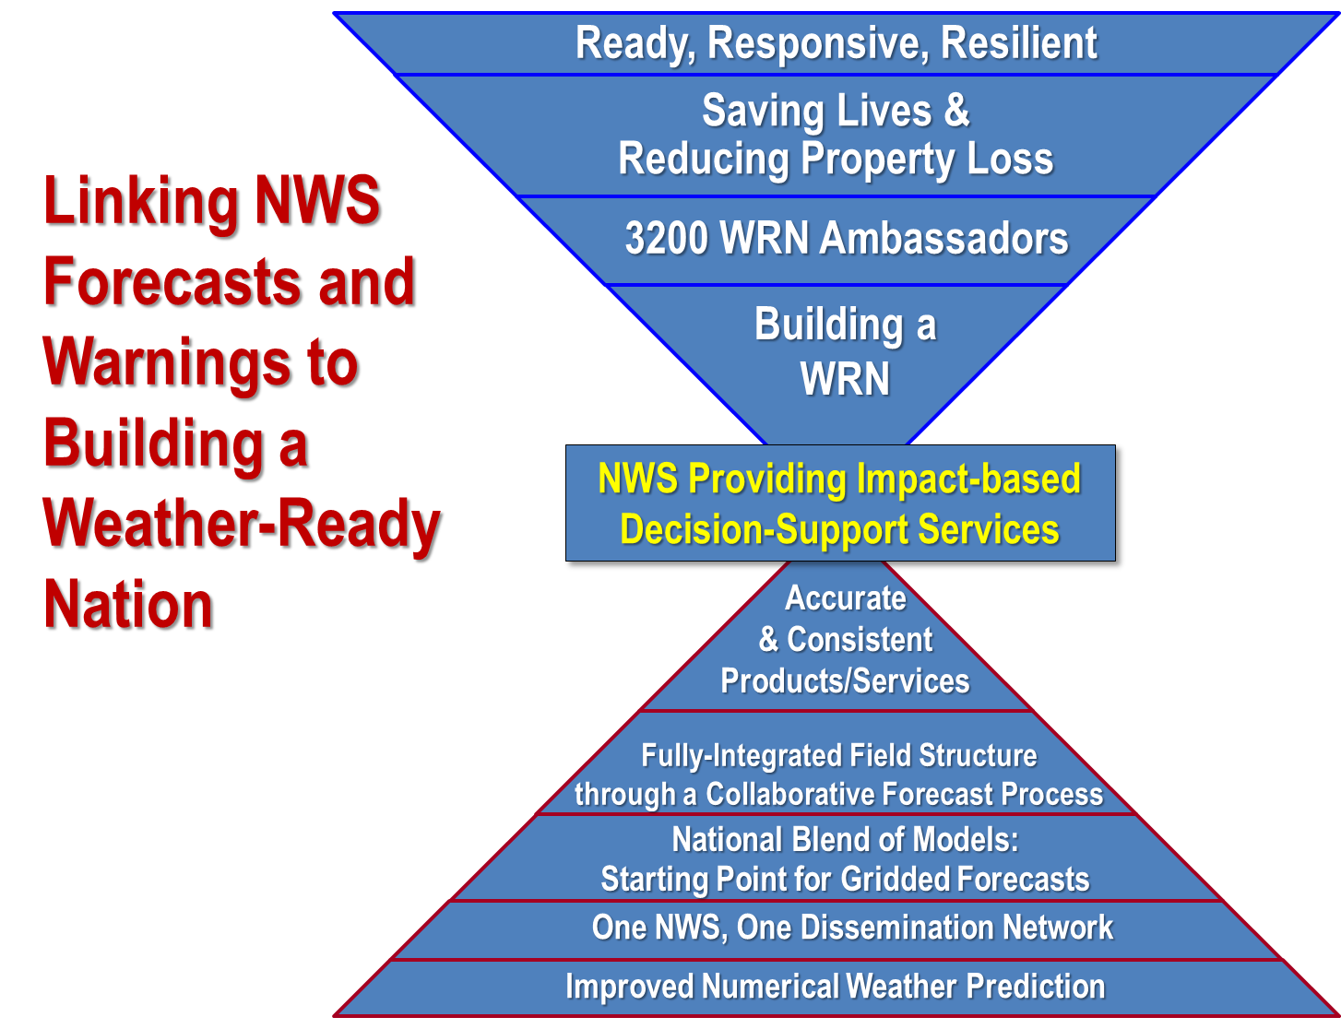
NWS is building on its science-based service operating model to achieve a Weather-Ready Nation
Notes:
Fundamentally, we are shifting from a production-orientation to a service-orientation. That means moving towards staffing based on IDSS, allowing our staff to specialize according to partner needs and their skills, training our staff in both science and service, aligning our operating hours to our partners, and making sure our staff spend time where it matters most.

Slide 15
Delivering on the science-based service operating model requires additional changes to field office structure, workforce, and operations
From the operations and workforce of today …
…to an operations and workforce positioned for IDSS needs of tomorrow
“One size fits all” staffing based on requirements of the past
Staffing levels based on IDSS
“Jack of all trades” roles at WFOs
Strategic specialization of roles
Each office must fully support itself
Field offices in the same area support each other and their partners
WFO staff constrained by 24/7/365 shift requirements
Local staff operate business hours to match their partners
Staff operate forecast “desks”
!
Staff focus on areas of highest impact
!
!
SOURCE: OWA Strategic staffing team, June 2016
Notes:
Fundamentally, we are shifting from a production-orientation to a service-orientation. That means moving towards staffing based on IDSS, allowing our staff to specialize according to partner needs and their skills, training our staff in both science and service, aligning our operating hours to our partners, and making sure our staff spend time where it matters most.

Slide 16
NWS has committed to shifting the way the field spends its time but must overcome challenges in the current field structure
Conceptual diagram of how a WFO spends its time¹
Key challenges
Current
Future
Leadership &
administration
Leadership &
administration
Span of control too high
Science & training
Limited dedicated support for R2O, O2R, and training
Science & training
Supporting observations
Some systems support functions (e.g., COOP, IT) could be better managed across WFOs
Warning issuance
Supporting observations
Warning issuance
IDSS
Difficult to develop given warning frequency in many offices
Limited “bench” of warning experts given WFO staffing model
24/7 met watch at all offices is an inefficient use of resources
IDSS
Situational awareness
Gridded forecast production
Staff not positioned where needed most, and constrained by 24/7 ops
Staff time for IDSS constrained by forecast production requirements
Situational awareness
IDSS forecast products
1 Based on best data available including standard role mix, position descriptions, and interviews; testing and evaluation in FY17 will quantify time saved; could vary across WFOs; 2 Not exhaustive; 3 Includes dissemination, AWIPS, QA/QC data, observations network maintenance, and autosonders as appropriate
SOURCE: Interviews and job shadowing during ~40 office site visits from May 2015 – January 2016
Notes:
2 min
The big shift is around how you spend time in your day. It’s based on the science – more time do more real analysis. A collaborative forecast process is a better use of time from a customer point of view, and allows for much more time for innovation for our meteorologists and more time for coaching for managers
So you can see that the purple/pink section, where we focus on our “bread and butter” - watches/warnings, and communicating those high impact products out, that’s where the majority of a forecasters time will be.
Each office is a “front door” to the broader NWS and NOAA, tapping into expertise elsewhere. Focuses human input where most critical and allows technology to free up time where possible
Exciting for staff because: more dynamic office environment, more time for training and science-based research, more local innovation, more relevant to partners, more flexible in terms of schedule
As needed:
Managing observations detail:
+Identifying and making partnerships with other NOAA observations offices
+Improving use of technology such as autosondes
Situational awareness detail:
+Not waiting for partners to come ‘in the door’, going ‘out the door’ proactively to help partners
+Managing and responding to ”weather information” = ever increasing amounts of data to stay aware of, reviewing information put out across NWS and NOAA
+Managing and responding to ”incident information” = what’s going on beyond weather that might matter to our partners and where we can help (e.g., tire fires / avian flu)

Slide 17
The Fully Integrated Field Structure effectively and efficiently aligns NWS resources to unleash the potential of its staff to protect lives and property
Future NWS field office functions and illustrative time allocation
Alignment in the Fully Integrated Field Structure
5
Leadership &
administration
Strategic alignment of support through resource pooling increases dedicated support for key functions and collaboration across offices, while also ensuring as many staff as possible are available to serve partners
4
Science & training
3
Supporting observations
Focused, experienced warning staff. Expert warning staff would provide 24/7/365 warning production across CWAs related by climatology and partner needs. Warning staff time would be focused 100% on training, monitoring emerging situations, developing warning products, and communicating with IDSS staff
2
Warning issuance
1
Recurring and event-driven IDSS, including messaging warnings
Distributed IDSS staff. IDSS staff would be distributed across the country according to core and deep partner needs. IDSS staff would operate under business hours unless needed overnight, and focus time on developing and providing critical forecast and hazard information, not general forecast production. IDSS would be based on a collaborative forecast process that layers expertise from national and local staff onto a central, common starting point without local grid editing
IDSS forecast products
Situational awareness
SOURCE: OWA Strategic staffing team, June 2016
Notes:
DISCUSSION DOC
What we have shared with you here is a vision for a field structure that will support our mission. The biggest takeaway here is that this model will improve service for all partners and make the best use of our resources so that expertise is added where it has the most value. This is the vision we propose to rally around to give our tests shape and purpose.
The foundation of it is distributed IDSS – getting IDSS staff where they are most needed, when they are most needed. That is what our local footprint is for.
Then, we support those IDSS staff with expert warning staff at select locations, where they can use their skills often enough to sharpen them, and where they can still be familiar with the area – both partners and climate.
Finally, we align our training, R2O, O2R, observations staff, and leadership strategically. We can benefit from having dedicated research and training positions around the country, rather than asking all our SOOs to split their time. We can match leadership levels with the scale of the office and the decisions being made. We can manage our observations network across CWAs to be most effective.

Slide 18
Distributing IDSS staff according to partner needs ensures partners have access to expertise when they need it
1
Future NWS field office functions and illustrative time allocation
5
Leadership &
administration
4
Science & training
3
Supporting observations
2
Warning issuance
Distributed IDSS staff. IDSS staff would be distributed across the country according to core and deep partner needs. IDSS staff would operate under business hours unless needed overnight, and focus time on developing and providing critical forecast and hazard information, not general forecast production. IDSS would be based on a collaborative forecast process that layers expertise from national and local staff onto a central, common starting point without local grid editing
1
Recurring and event-driven IDSS, including messaging warnings
IDSS forecast products
Situational awareness
SOURCE: OWA Strategic staffing team, June 2016

Slide 19
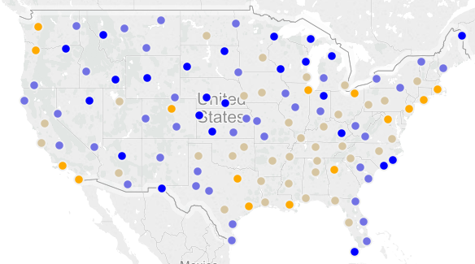
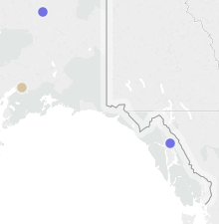
One-size fits all staffing and operations. NWS staff are not positioned to most effectively provide IDSS and meet the enhanced mission of protecting lives and property
1
PRELIMINARY
Excess
capacity
Excess
demand
NWS estimated the demand for IDSS staff across the country using workload drivers (e.g., weather type and frequency, population, partners) and benchmark estimates of number of staff needed to meet demand
IDSS demand is contingent on testing and evaluation, including ongoing IDSS partner categorization
Preliminary estimate of capacity available vs demand for IDSS
# of FTE for IDSS¹
Example: Montana state EM would benefit from co-located fire expert
Example: Port Authority of NYC not fully served today
Example: CDC in Atlanta interested in additional support
Example: FEMA would benefit from dedicated liaisons
To be further refined based on IDSS tabletop exercises
1 Based estimates of IDSS need according to weather impacts, people and property at risk, and partner presence
SOURCE: OWA Strategic staffing team preliminary output, June 2016
Notes:
DISCUSSION DOC
When we estimated demand across the country – based on consistent criteria and benchmarks of current staffing levels required to provide deep IDSS (for example from the IDSS pilot) – we learned that we are underserving critical partners in some parts of the country. Although our customers reported high levels of satisfaction, we also know that there are many examples of partners looking for more. We have heard from EMs who could not get NWS support for their EOCs and therefore had “delayed operations every day due to not being able to understand the forecast.” We have heard from partners like the CDC and FEMA that they need more dedicated support for their operations. And we know that many partners are looking for additional expert support – fire weather experts in the summer out West, ice expertise in Alaska – increasingly we are called on to be specialist, highly flexible experts for our partners.

Slide 20
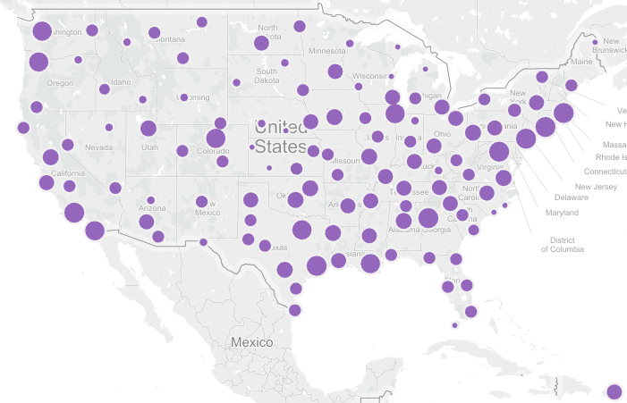
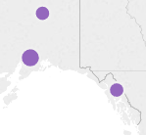
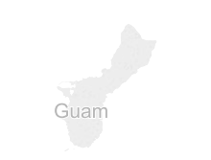
To best meet partner needs today, NWS could strategically position IDSS staff
1
ILLUSTRATIVE AND SUBJECT TO TESTING
3-5
9-11
Example distribution of IDSS staff based on partner demand today
# of IDSS staff per office (does not include staff for other functions)
6-8
12-16+
Partners would receive IDSS support greater than or equal to today, with 3-5 dedicated IDSS staff and surge support as needed from other offices
ILLUSTRATIVE
Number of staff subject to testing and future demand
Map only shows IDSS staff – additional staff are needed for other critical functions
SOURCE: Illustrative output based on OWA strategic staffing exercise, June 2016
Notes:
DISCUSSION DOC
Our preliminary application of the criteria show that IDSS demand varies across the country in terms of how many staff may be needed to fulfill it.
This is not a perfect science, and we will use the ongoing partner identification “tabletop exercise” to refine our criteria and how we apply them, and as we test and evaluate new delivery models we will adjust as needed.
It is important to note that some offices would have fewer staff if they were staffed according to workload, but that their partners would receive just as much, if not more, service – for instance, in one of the small dots today, there may be 12 mets, but only the WCM, MIC, and effectively 1-2 others are able to dedicate time to supporting them directly. In the future, there may be 3-5 dedicated IDSS staff serving them, based on the foundation of the collaborative forecast process and the dedicated warning staff.

Slide 21
Focused, experienced warning staff could enhance quality of warning products and services
2
Future NWS field office functions and illustrative time allocation
5
Leadership &
administration
4
Science & training
3
Supporting observations
Focused, experienced warning staff. Expert warning staff would provide 24/7/365 warning production across CWAs related by climatology and partner needs. Warning staff time would be focused 100% on training, monitoring emerging situations, developing warning products, and communicating with IDSS staff
2
Warning issuance
1
Recurring and event-driven IDSS, including messaging warnings
IDSS forecast products
Situational awareness
SOURCE: OWA Strategic staffing team, June 2016

Slide 22
Jack of all trades staffing model. NWS staff are not positioned to consistently develop expertise in warning production, sustain expert operations, and guarantee consistency
2
Minimal activity
Insufficient expertise
Sufficient expertise
Even in CWAs with significant activity, forecasters do not get sufficient “at bats”
Current field structure does not ensure sufficient expertise
Insufficient warning volume within at each WFO to provide each individual enough experience issuing warnings and ensure sufficient “depth of bench” at each WFO
In fair-weather, mets have to split attention between monitoring for immediate-term threats and producing forecast
Multiple WFOs may issue warnings for related events, and may do so under different guidelines
Warnings per forecaster per year by type¹
Warning data 2008-2015¹
Severe
Marine
Flash flood
Tornado
Winter storm
3
1 Based on full staffing of 12-14 mets per office, assuming mets need 1 warning per month for severe and marine warnings, 1 warning per month over 4 month season for flash floods, tornados, and winter storms
SOURCE: OWA discussions and analysis; NWS warning data 2008-2015
Notes:
DISCUSSION DOC
Coming back to the warning conversation, we want to make it clear that we are considering significant change but not a wholesale shift to a centralized model. The area model allows us to gain the scale needed for expertise and a deep bench for spinning up, and to ensure consistency of warning issuance across CWAs. Further consolidation could provide additional scale benefits but given that these offices would also serve a 24/7/365 “met watch” and “first point of contact” mission for the area, it is likely we would need that footprint to serve partners anyway.
As you may have seen in the phased approach in the pre-read, Phase 2 is step 2 on this spectrum - freeing up the overnight or ‘swing’ shifts through a warning backup protocol. That move provides a significant unlock of staff time, but it does not provide the expertise and depth of bench gains that coverage by area does. It also requires handovers of warning responsibility that may put service at risk.

Slide 23
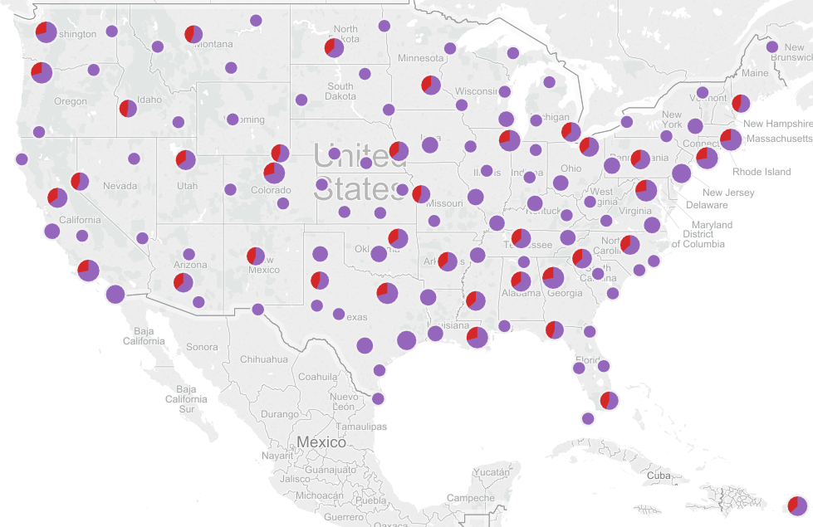
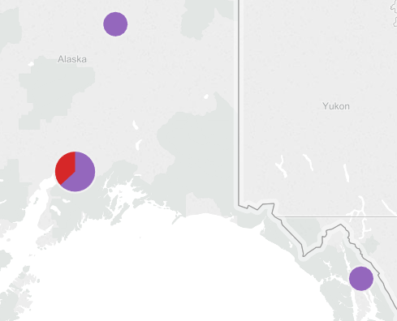
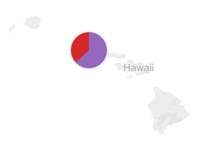
Dedicated warning staff would be positioned to develop high quality products and enable high quality service
2
ILLUSTRATIVE AND SUBJECT TO TESTING
Dedicated warning support would be provided by area, with warning experts and IDSS experts involved in the process
This concept requires significant testing and evaluation:
Science-based tests to ensure no degradation of lead time or accuracy
Service-based tests to ensure partners receive high quality information
Example alignment of IDSS and warning staff based
on workload for all warning types and IDSS
Office size range by location
3-5
IDSS
6-8
15-17
Area grouping
Warnings
18-22+
ILLUSTRATIVE
1 Office sizes vary within each range. Some office numbers include embedded and/or “satellite” staff
2 Grouped offices could collaborate extensively to provide best services to partners, (e.g., IDSS expertise, dedicated area warnings, and support functions). Groupings could balance workload (e.g., volume of warnings)
SOURCE: Illustrative output based on OWA strategic staffing exercise, June 2016
Notes:
DISCUSSION DOC
I want to provide context for this map. This map is NOT a map we are committing to in terms of office size and functions. I can imagine many versions of this map being where we land in the future – for instance, perhaps NJ and NYC should be served by the same office, with an additional office service upstate NYC. Perhaps there are further benefits available from a warning center serving both Alabama and Georgia. Or, testing could show that additional warning offices are needed to maintain service levels. Further analysis and testing is needed both on the science and service side before putting forward a strict vision of office sizes.
This version of the map shows ~40 groupings of offices – with roughly 1 warning office per state, with exceptions where states are large, or sparsely populated, or have very high demand partners. The warning offices are mostly high and extreme IDSS offices – meaning they will have significant numbers of IDSS staff in that office. During an event, IDSS staff can provide coverage for additional radar desks if needed, creating a deeper bench during an event. The size of the warning team can vary by warning frequency in that area.
It is important to note that all dots within each box would receive support from the other offices in their group – again, this model should increase service to partners.

Slide 24
Strategic alignment of support staff can ensure maximum support for science-based service to partners
3-5
Future NWS field office functions and illustrative time allocation
Fully Integrated Field Structure approach
Groups of local offices (WFOs, CWSUs, RFCs) receive support for cross-cutting functions from dedicated coordinators in their area
Observations network requires management above the CWA-level (e.g., COOP program, ensuring optimal coverage of ASOS sites)
Research to Operations (R2O) and Operations to Research (O2R) projects could be coordinated above the CWA-level, involving local staff as appropriate
Training could be coordinated above the CWA-level to ensure national training materials reflect local needs and all staff receive consistent training
Presence is maintained in offices for functions that require consistent on-site support
Some IT and electronics maintenance functions
In-person training support
Administrative functions in large offices
Leadership span of control is brought down to 4-6 reports
Additional supervisors would be identified for large offices
5
Leadership &
administration
4
Science & training
3
Supporting observations
2
Warning issuance
1
Recurring and event-driven IDSS, including messaging warnings
IDSS forecast products
Situational awareness
SOURCE: OWA Strategic staffing team, June 2016
Notes:
DISCUSSION DOC
Although we are not going to spend as much time on it today, it is very important that we align our support functions where they can be most effective. There are many functions today within each WFO that could be best delivered across groups of WFOs. As we move to an asymmetric model this is even more important – if we have small offices of 5-10 staff and large offices of 30+ staff, they will need very different levels of support.
As an example, we can create dedicated positions to support research across an area, where we cannot do that within each WFO. Similarly, we can create a training manager position at an area level to ensure consistent training across multiple offices. We will also explore options to bring leadership span of control down to best practice through creation of additional supervisory positions.

Slide 25
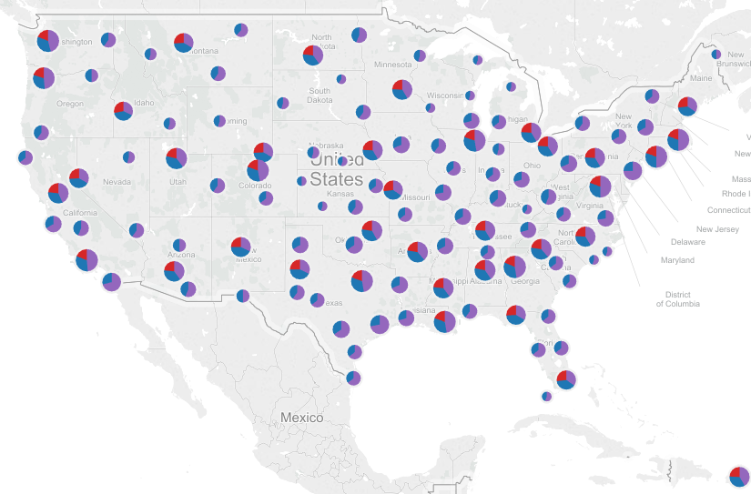
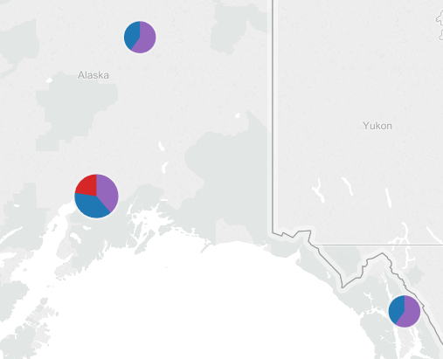
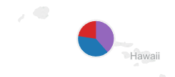
NWS can strategically align its workforce to meet partner needs and achieve a Weather-Ready Nation
3-5
ILLUSTRATIVE AND SUBJECT TO TESTING
All core and deep partners receive increased support through:
IDSS from local experts when and where needed
Focused, experienced warning experts in their area
High quality forecasts informed by expertise at all offices, including NCEP and NWC, based on a common operating picture
Example alignment of workforce to today’s workload
Office size range by location¹
<10
IDSS
10-19
Warnings
20-29
Support²
30+
ILLUSTRATIVE
1 There are offices of all sizes within these ranges, and offices could include embedded / “satellite” staff
2 Includes staff for supporting observations, science & training, and leadership & administration
SOURCE: Illustrative output based on OWA strategic staffing exercise, June 2016
Notes:
Adding on the support functions layer, we see how office sizes could differ dramatically across the country, and that at each office there is IDSS and some level of support (electronics making up the bulk, and then leadership and training). Again, this map is illustrative – it is based on a preliminary analysis of needs across the country – but it provides a compelling vision for how NWS could look to partners and it shows the significant work we have ahead of us.

Slide 26
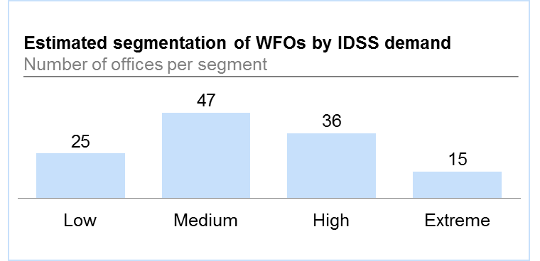
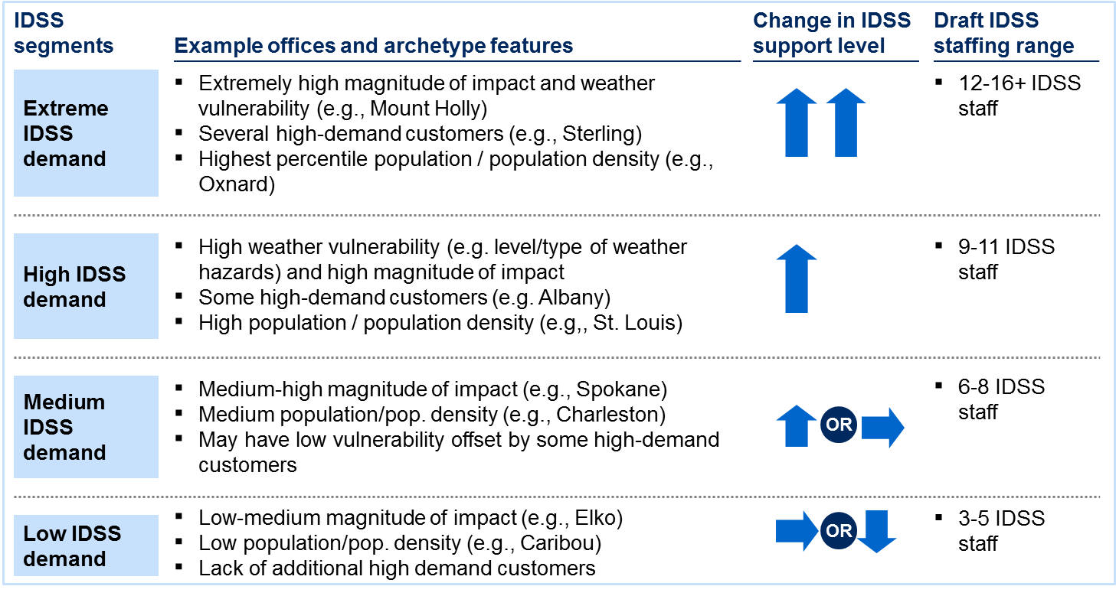
Initial estimates of IDSS demand – 2X today’s resources for IDSS – suggest an “unlock” of NWS staff time is needed to support this operating model
NWS has estimated demand for IDSS today…
Based on IDSS segmentations, future IDSS demand could require 900-1,400 staff members worth of time (FTEs), as well as 100-200 FTEs for IDSS and support functions at other field offices (e.g., NCEP, NWC, RFCs, RHQs, ROCs)
Currently, IDSS is being delivered by some dedicated staff, and a portion of other staff time, estimated to total ~400-600 FTEs¹
…which requires a resource “unlock”
400-600
1,000-1,600
600-1,000
37
14
Total IDSS need (FTE)
Current IDSS (FTE)
“Unlock” needed (FTE)
1 Dedicated staff, for instance, are the 122 Warning Coordination Meteorologists (WCMs) and 13 Service Coordination Hydrologists (SCHs), and roughly 40 offices with a staffed IDSS desk at least 1 shift per day; of the additional ~1,800 mets and hydrologists in local offices, ~10-25% of their time may be spent on IDSS currently, putting total estimate of time spent on IDSS today at ~400-600 FTEs
SOURCE: OWA Strategic staffing team, June 2016; MIC survey, April 2016
Notes:
DISCUSSION DOC
We can achieve this vision within our current staffing levels, but it will require “unlocking” 400-900 of our meteorologists in the field today to refocus their time, operate at different times of the day, or change offices. This does not mean we need additional staff – as you see on the following pages, there are ways to meet this demand within our current staffing levels, and the estimated staffing levels need to be tested and evaluated.

Slide 27
NWS has identified several ways to achieve “unlocks” needed to provide deep relationships IDSS
Seven functional and form “unlocks” can provide significant flexibility for NWS field offices
1
Strategic staffing
NWS could move away from cookie-cutter staffing, allowing staff to be distributed to meet partners where they are
Collaborative forecast process
Field offices could use a common operating picture to share expertise – local forecasters focus on interpreting information for their partners
2
3
5-12 pathway
Updated career progression for mets could increase time spent by GS 5-11 meteorologists contributing to IDSS
4
Autosonders
Automated launches could increase flexibility for resources currently deployed for balloons specifically (particularly for demonstration purposes in AK region)
Shift scheduling flexibility
Office schedules could be set strategically to address partner needs, so not all offices devote resources to staying open 24/7. Requires warning backup to be provided from another office, as well as on-call procedures
5
6
Staffing flexibility
Offices could adjust rotation to best serve partners, without requiring each shift to have two staff members
7
Strategic positioning
Locate offices and functions to best serve partners and meet internal NWS needs (e.g., IDSS staff near partners, maintenance staff near strategic needs)
SOURCE: OWA Strategic staffing team, June 2016
Notes:
DISCUSSION DOC
We have identified 7 “unlocks” – strategic staffing is the notion that we would release the constraint of ~12 mets per office, the collaborative forecast process is about shifting how our forecasters spend time, the 5-12 pathway allows us to use our current resources more effectively, autosonders add some flexibility to office operations, releasing the 24/7 requirement allows us to shift staff to daytime hours, staffing flexibility allows us to go down to 1 person on shift if needed, and strategic positioning allows us to embed, deploy, or even move an office if needed to support partners
As you see on the following page, we are going to need to make progress on all of these unlocks to meet demand.

Slide 28
Each “unlock” contributes to the flexibility needed to meet demand for IDSS
Unlocked flexibility
Lost flexibility
PRELIMINARY
Tools used to achieve strategic staffing in the future operating model, FTE
~600
TBD
200-400
Status quo
Strategic staffing need
Colla-borative forecast process¹
5-12 pathway³
Auto-sonders⁴
Met watch backup for shift scheduling flexibility
Flexibility unlocked
No shift scheduling (24/7) flexibility⁵
No staffing flexibility⁶
No strategic positioning
Remaining flexibility unlocked
Tools
1
2
3
4
5
5
6
7
Functional “unlocks”
Form “unlocks”
1 Based on 2 shifts per day (4 FTE) per WFO focused on forecast production
2 Based on 1-2 shifts staffed overnight (2-4 FTE) at ~80 offices, and 1-2 evening shifts (2-4 FTE) at low offices (~25)
3 Based on 50% of GS-11s (180) become GS-12. Of additional intern time, 30% of intern time could be shifted to higher value IDSS activities
4 Assuming 3 FTE at each AK WSO, add’l 1 hr/day at 80 sites totaling 560
hrs/week (14 FTE at 40 hrs/week). Total of 50-100, if full contracting at all sites
5 Requires low IDSS offices (25) operating business hours to add two shifts per day, medium IDSS offices (47) to add one shift per day
6 Requires low and medium IDSS offices to add second person two shifts per day, high IDSS offices (40) to add second person one shift per day
SOURCE: OWA Strategic staffing team, June 2016
Notes:
DISCUSSION DOC
We can see that making progress on the collaborative forecast process, based on the NBM, is critical and may present an early opportunity to refocus time. We also need to develop a 24/7 backup capability for warnings to allow for shift scheduling flexibility. And while it isn’t shown here, it is important to note that if we don’t take the additional step towards creating dedicated warning teams, our IDSS staff will be playing the dual role of IDSS and warning production, meaning they are less flexible to respond to partners and less able to develop deep expertise.
It’s important to note that as we build up flexibility on the left side, we can lose that flexibility if we do not achieve the “form unlocks” on the right side. Labor negotiations will be critical here.

Slide 29
NWS will take a phased approach to transition to the vision – this will not be a “light switch event”
Phase 2: Form and function
evolution
Phase 3: Vision
Phase 1: Similar functions,
more flexibility
Description
Some strategic staffing via changes to requirements on staffing and in the forecast process
Additional strategic staffing via changes to operating hours and improvements in forecast process
Further flexibility via tailored locations and a fully implemented collaborative forecast process
“Unlocks” used
Some strategic staffing
Collaborative forecast process enables WFOs to limit grid production to high impact edits
5-12 pathway generates additional forecasters at the GS12 level available for shifts
Shift staffing flexibility increases mets available on day-time shifts
Autosonders provide forecasters some additional time for IDSS
Additional strategic staffing
Collaborative forecast process further enables WFOs to reduce time spent on routine grid production,
Shift scheduling flexibility gives offices option to match partner hours, with backup provided by office in area
Fully use of autosonders
Some strategic positioning of staff allows more in-person service
Full strategic staffing
Collaborative forecast process and further technology improvements allow WFOs to focus only on forecast products as needed for IDSS (e.g., spot forecasts)
Focused, expert warning staff provide service to offices and partners in an area
Strategic positioning of staff allows more in-person service
% of IDSS demand met
50%
65%
100%
SOURCE: OWA Strategic staffing team, June 2016
Notes:
DISCUSSION DOC
It is so important to note that this will not be a light switch event – we will first focus on several unlocks that are achievable early on; at the same time we will test the capabilities needed to move to “Phase 2”, in which offices can reduce hours, and eventually to “Phase 3” where there is no grid production in local offices and staff can shift to meet IDSS demand across the country.

Slide 30
NWS will communicate with key stakeholders to gather input, involve them in tests, and support implementation
Legend:
In person meeting
Email
Webinar
Clearance Step
Action
Date
NWS lead
Format
Review and approve content during OWC
Mid June
OWA Core Team
OWC and LU/LF
Support sharing plan
Approve approach and content for OMB, Hill staff
NOAA: July 11
DOC: July 25
Furgione / Draggon
NOAA / DOC
OMB Leadership Briefings
Key Hill Staff Briefings
Other stakeholders
OMB: late July
Hill: week of 7/25
NWA, IAEM, AMS, NAPA, NAS: late July
NOAA Legislative Affairs
External Stakeholders
VTC NWS Directors’ Brief
Week of 8/1 or 8/8
Furgione / Draggon
NWS SES
Distribute memo and slides to Managers and NWSEO
Host a series of webinars
Mid August
OWA
NWS Labor Team
NWS Managers
NWSEO
Attend webinar to learn about options; attend office meeting and share input
Mid-late August
OWA
All Staff
Local partner engagement by a mix of regional and national staff to follow the all staff briefings

